Slide 1

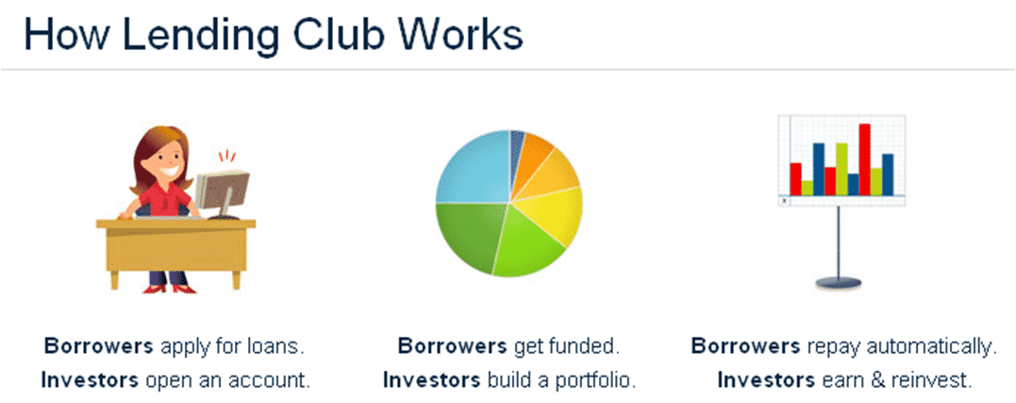
Online Lending Club
Prepared By:
Khalid Mohamad Aladin Hafez Omar
Email:khalidomarasu@gmail.com
Nadeem Akhter
Email:MNadeemAkhter@hotmail.com

Slide 2
Outline:
Lending Club is a marketplace in US for personal loans that matches borrowers who are seeking a loan with several investors looking to lend money and make a return.
Goals
Be Profitable
Have better understanding of its customers
Approve profitable loans and reject risky loans
Concerns
Approving Risky loans
Losing investments or investors
Requirements
EDA on previous Data to Understand variables leading to Risky Loans
Predict bad loans using those driving variables
Objectives:
The company wants to understand the driving factors behind a defaulted loan default, i.e. the variables which are strong indicators of default. The company can utilize this knowledge for its portfolio and risk assessment.
We will analyze the past dataset by using EDA to understand customer and loan patterns with respect to their influence on not repaying loan on time or simply defaulting the loan.

Slide 3

EDA Road Track
Analyze and impute empty values:
Disguised Missing values
Significant number of Missing values in a row/column
Partial missing values
Fix Invalid Values:
Incorrect data types
Correct values beyond range
Validate internal rules
Data Cleaning
Fixing Columns:
Delete Unnecessary columns (or irrelative (behavioral) to defaulter analysis)
Deleting Unique Identifier columns
Deleting columns with more than 85% Null values.
Delete duplicates if any.
Bivariate Analysis:
Understanding how combination of 2 variables estimates a defaulted loan.
Check correlations
Univariate Analysis
Frequency, Distributions
(Categorical and Numerical)
2
2.2
3
5
Conclude driving variables.
Conclusion
7
1
2.1
2.3
4
6
Data Sourcing and Understanding:
The Data has 39,717 rows and 111 columns
The data set available is loans.csv which represents the data for 4 years.
Understanding columns using dictionary
Fixing Rows & Identifying and Treating Outliers:
Extra rows -> Outliers were deleted and all values with Current in loan_status column were deleted
Derived Metrics
Data/Business/Type):
Creating Bins:
Segmented Analysis
Multivariate Analysis

Slide 4
Data Understanding
Understanding:
The data provided is loans.csv which represents the data collected from years 2007 to 2011
There are 39,717 rows and 111 columns in this dataset.
The data have 56 columns with 85% or more null values.

Slide 5
Data Cleaning:
Cleaning:
Columns with more than 85% null values, have unique identifier values, behavioral variables.. Were all dropped.
Outliers identified
Extra rows -> Outliers were deleted and all values with Current in loan_status column were deleted.
Removed loans with less than 100 value and fixed high precision values to two precision
Analyze and impute empty values (Disguised Missing values, Significant number of Missing values in a row/column ,Partial missing values)
Derived Metrics( Data/Business/Type, Creating Bins)

Slide 6
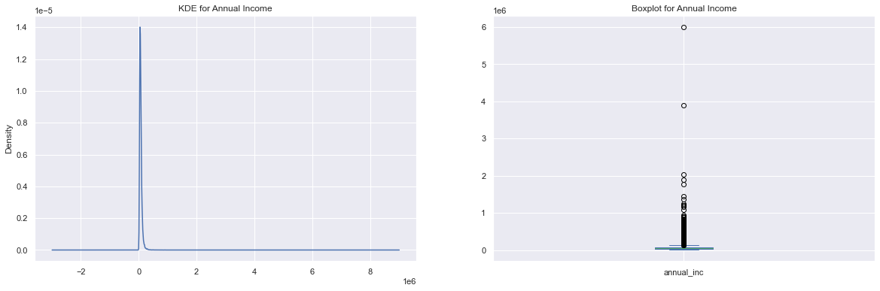
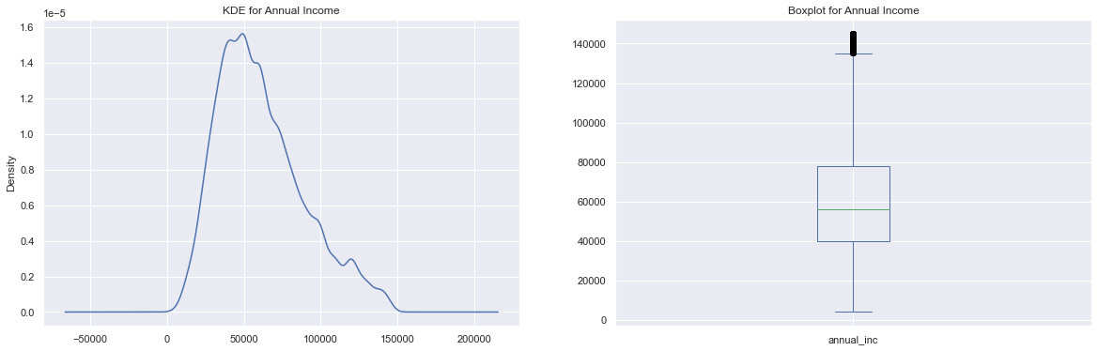
Outlier treatment (Example Annual Income)
Before Removal
After

Slide 7
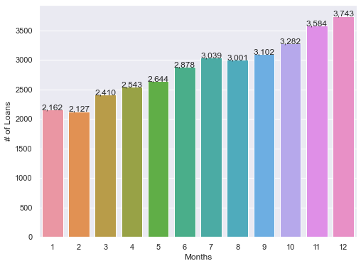
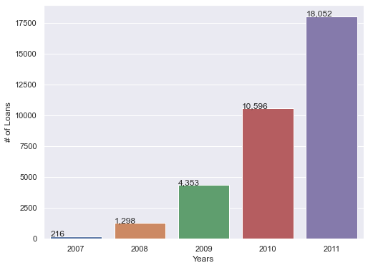
Derived Metrics:
New derived variable: Month from Issue Date (issue_d) column
This shows that the number of loans approved in December is the maximum
New derived variable: Year from Issue Date columns
The number of loans issued by the lending club is increasing each year in 2011 it had the maximum no. of loans.

Slide 8
Data Analysis:
Univariate
Bivariate
Multivariate

Slide 9
Univariate Analysis

Slide 10
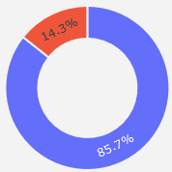
Loan Status
The total number of defaulted loans 4,999 Loans which represents 14.4% of the whole dataset
85.7 % of the loans issued are fully paid.

Slide 11
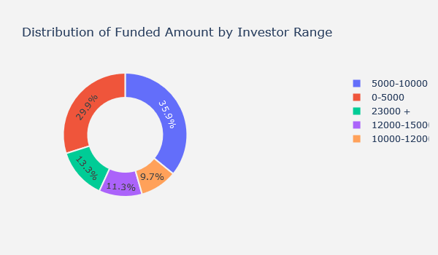
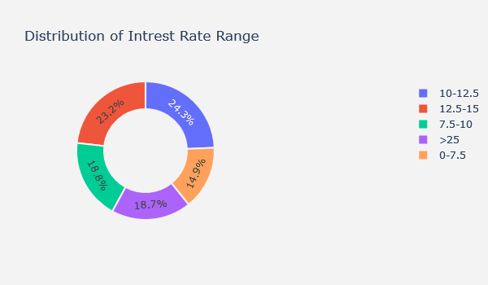
Funded Investors Amount
Annual Income Range
65.8% of investors invested from 0 to 10,000
13.3% of investors gave more than 23k USD to borrowers.
Only 10% of the loans issued range between 10k to 12k.
Almost 37% of the clients make 25k to 50k each year.
67% of the borrower's annual salary ranges between 25k to 75K
15% of the borrowers have a salary range of 75k to 100k yearly.
7.35% of the clients make less than 25K a year.

Slide 12
50% of the loans issued had an interest rate of 10 to 15%.
The maximum interest rate was 25% and more and it covers 18.7 % of the total loans issued.
The lowest interest charged on loans ranges between 0 to 7.5% and it represent 18.8% if the loans issued.
Only 15% of the loans issued had an interest rate less than 7.5%

Slide 13
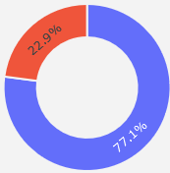
Term
77.1% of the terms issued are issued on a short-term plan of 36 months and only 22.9% were issued on a long-term plan of 60 months.
We can conclude that most of the borrowers take loans on shorter payment plans as an assumption reason of higher interest charged on long term plans.

Slide 14
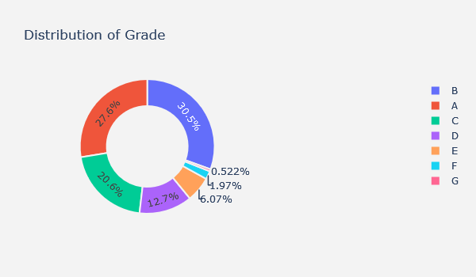
Grades
Grade B represents 30.5% of the total loans issued followed by A 27.6% and then C,D,E,F respectively.
We can conclude that 78% of loans issued lies in range of grades A to C.
Grades F,G represents a minority (2.5%) across the dataset.

Slide 15
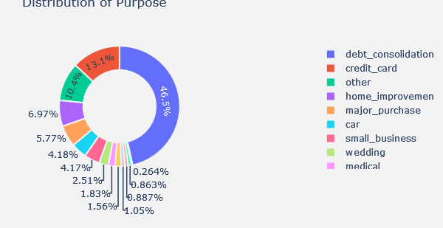
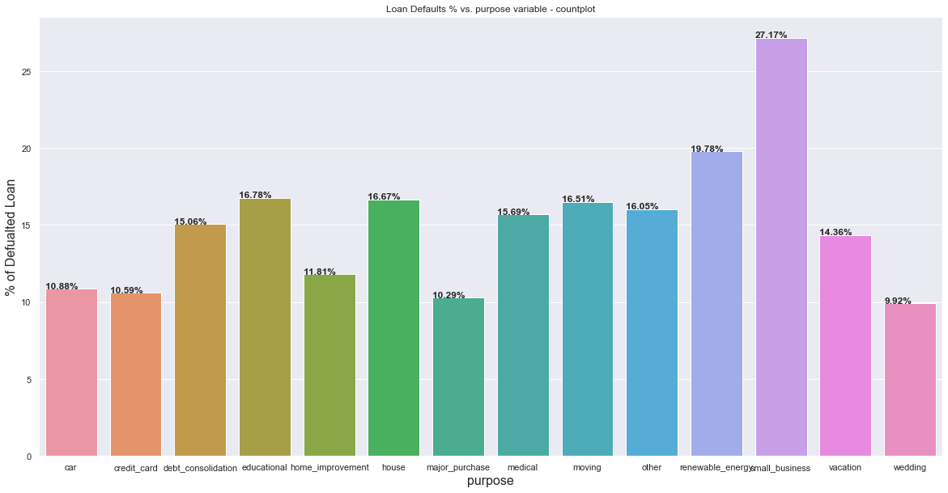
Purpose
Almost 50% of the borrowers took loan for the purpose of debt consolidation
We can conclude that 53.5% of the data is distributed between 13 different purposes.
The least count goes to loans for the purpose of renewable energy.

Slide 16
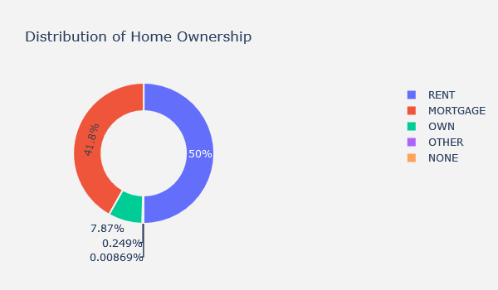
Home Ownership
We can infer from above that 50% of loan borrowers are renting and 41.8% have mortgaged their houses and only 7.87% of borrowers own a house:
We can conclude that people who own most probably have good cash flow thus 91.8 % of loan borrowers are those who rent houses or mortgaged their houses:

Slide 17
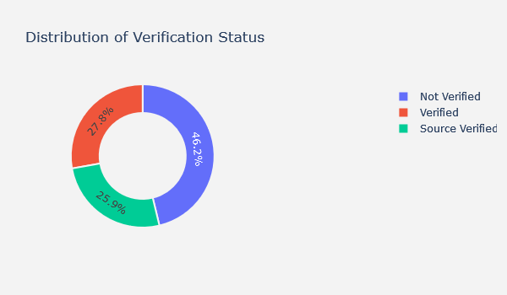
Verification Status
Almost half of the loans issued were issued to borrowers with incomes not verified.
Quarter of the loans were issued to income source verified customers and 27.8% of the loans were issued to verified income customer.
The plot shows normal distribution we can infer 53.8% of the loan were issued to Verified Income sources (Source Verified & Verified) and 46.2% were issued to customers with Un-verified income sources.

Slide 18
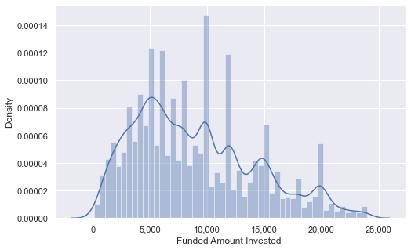
Funded amount Invested
Data shows multiple peaks and outliers which needs to be removed otherwise the numbers will be skewed

Slide 19
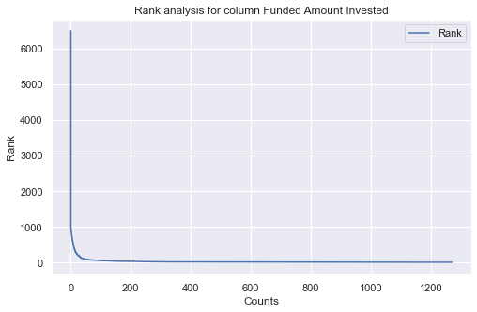
Rank Analysis for Funded Amount Invested
There are few values with higher rank (0 as the highest rank) as the line is almost vertical from around 0 to 10 counts
There are higher number of low rank values as the line is almost flat after around 10 counts
This shows that the loan amount is very distributed, and all amount of loans are being issued

Slide 20
Bivariate Analysis

Slide 21
Default Loan Analysis

Slide 22
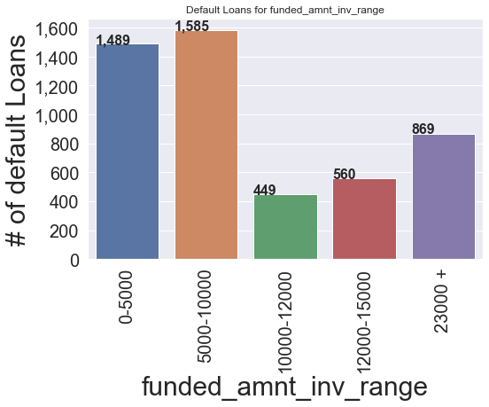
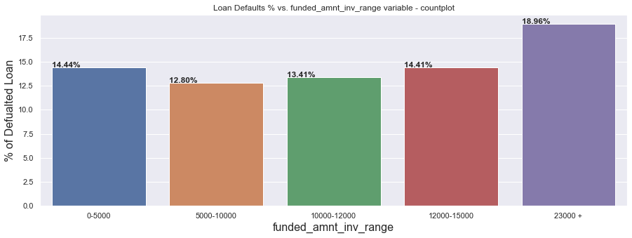
Funded Amount Invested
vs. # and % of loan default.
Most of the loans defaulted are for the small amounts. As most probably low amount are approved to people with lower grades and less securities thus, they can't pay back.
The loan amount approved by investor to borrower increase the chance of a loan to be defaulted increases slightly the higher the amount the higher the rate of defaulted loan.
Loan amounts above 23,000 shows the highest percentage of defaulted loans 18.96 %:

Slide 23
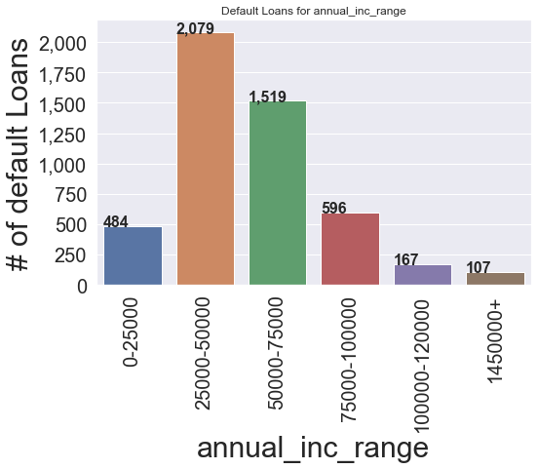
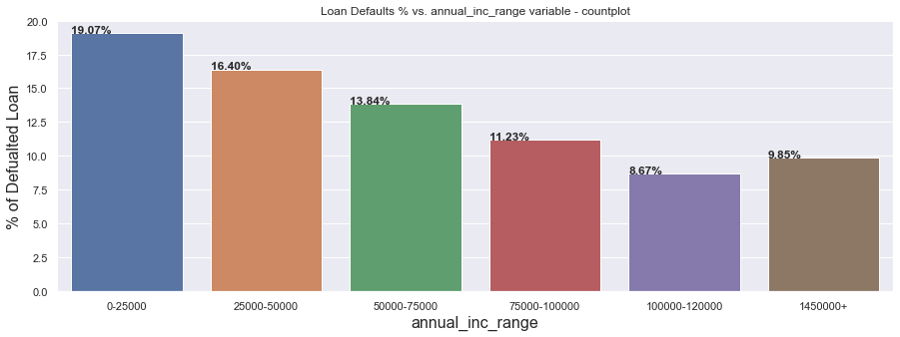
Annual Income
vs. # and % of loan default.
Clients with annual income range between 25 to 50K USD tend to have the highest count of defaulted loans. Take care of this category.
As the borrower's annual income increases the % of a loan to default decreases its inversely proportional.
The higher the annual income of a client the lower the chance of a loan to default.

Slide 24
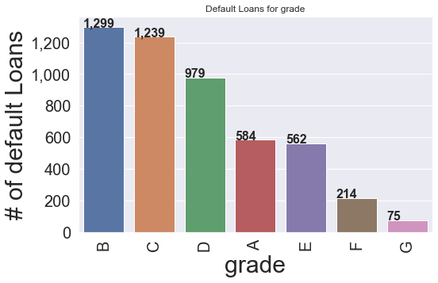
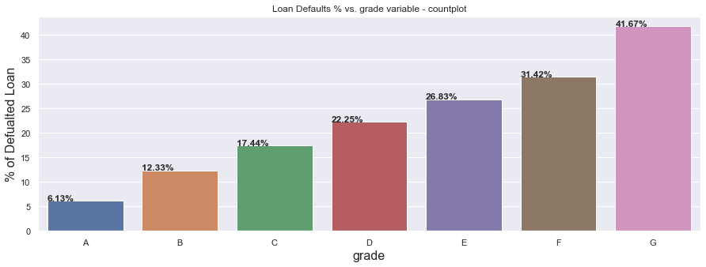
Grade vs. # and % of loan default.
Grade B has the highest # of loan default.
Loans issued are mostly with loans with grades B&C
As the loan grade moves from A to G the % of loan to default almost doubles between each consecutive loan grade A has 6.14% defaulters B had 12.43% defaulters Grade 'G' shows the highest % of loan to be defaulted.
We can conclude that if the loan was issued at a lower grade there is a higher chance for a loan to be fully paid.

Slide 25
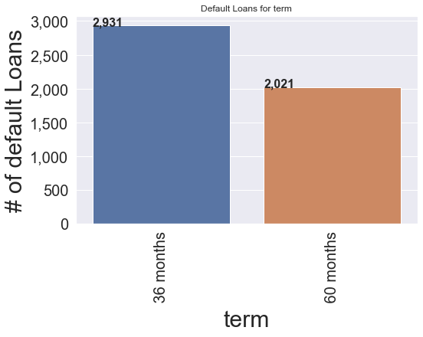
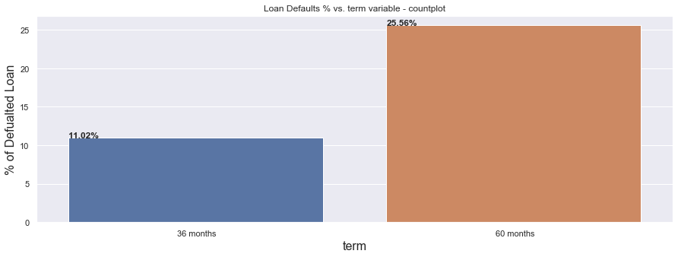
Term vs. # and % of loan default.
Loans issued with short term tend to have a greater number of defaults than long term loans.
As the loan term period increases the percentage of a loan to be defaulted increases slightly more than twice comparing 36-month period vs 60 months period:
We can assume the reason behind this is higher intrest rates charged on 60 months plan thus more chance to default.

Slide 26
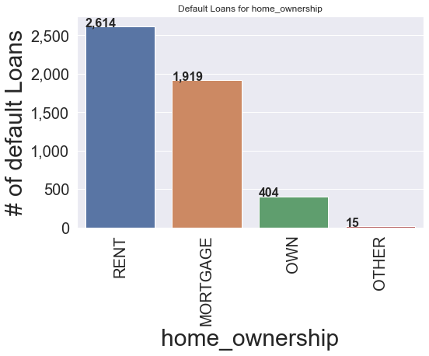
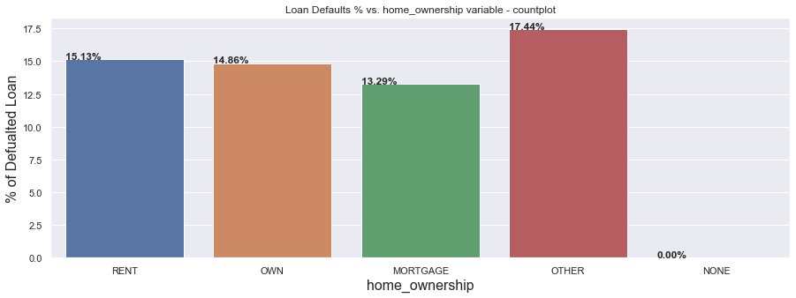
Home Ownership vs. # and % of loan default.
Clients with rented homes has the highest # of loan default. Be careful when issuing a loan client with rented house.
Lending money to people with rented houses reflects higher risk of a loan to default:
Lending money to people with rented houses reflects highest risk of a loan to default:

Slide 27
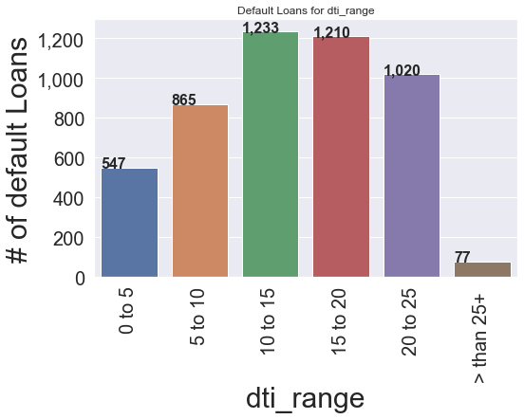
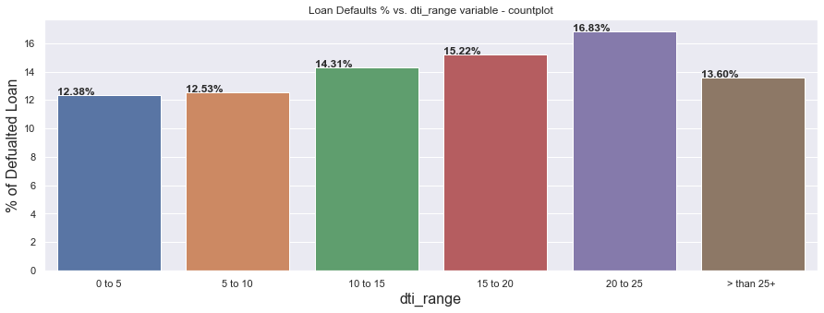
DTI
vs. # and % of loan default.
Clients with dti ratio of greater than 5 and less than 25 have high count of loan defaults.
Do not issue loans to clients with dti ratio >than 5
As the DTI ratio increase the % of loan to default increases. The lowest % of loan to default between ratios 0 to 5 which is almost 12.38% defaulter ratio.
Based on the data above we can infer that approving loans for dti range between 0 to 5 and 25 and above is better than 10 to 25 as a dti ratio.

Slide 28
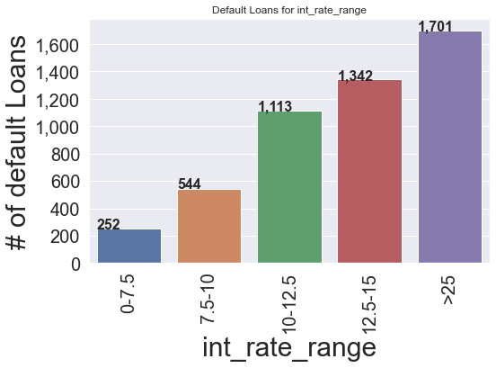
Interest Rate
vs. # and % of loan default.
Do not issue loans with interest rate 25% and more it has high default ratio.

Slide 29
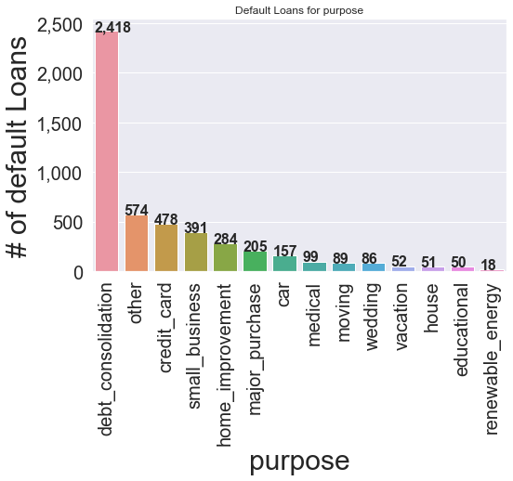
Purpose vs. # and % of loan default.
The highest chance for a loan to default is for debt consolidation.
We can infer from above that the puspose which has the highest % of loan defaults is "opening a small business" and the lowest % of loan to default is for weddings:
Approving loans for weddings, car, credit cards is better than approving loans for small business.
This could be a reason of small business usually are not well studied and implemented while weddings refer to people planning to start a new life after saving enough money.
Conclusion based on data distribution most of the loans issued are for the purpose of debt consolidation which shows 15.12% of loan default

Slide 30
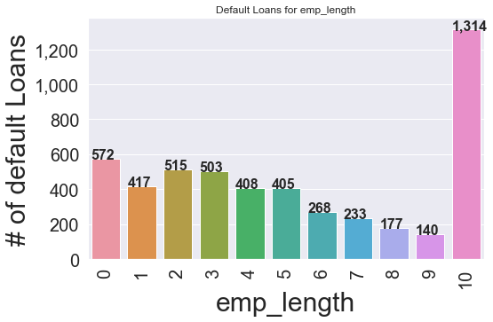
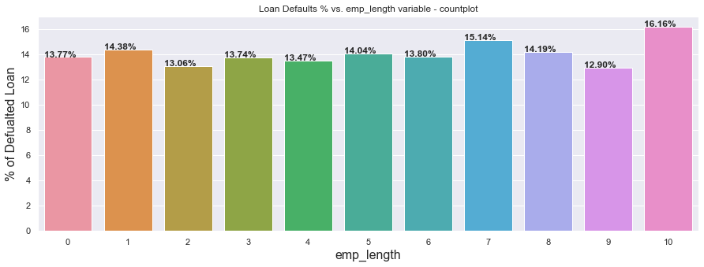
Employment Length vs. # and % of loan default.
The highest number of loan defaults are for employees with 10 or more years this could be a reason as people are mostly retired no source of income.
Employees with 10 or more years tend to show highest % of loan to default noting that 23% of the loans issued where issued to this category.

Slide 31
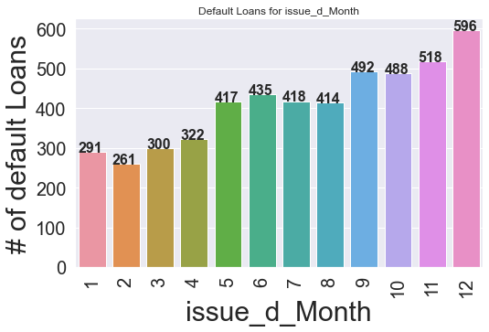
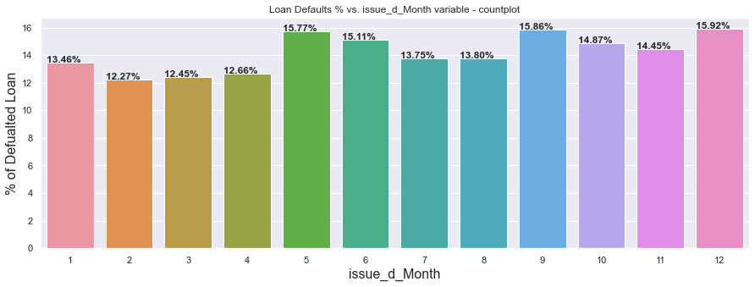
Loan Issue Month vs. # and % of loan default.
As the year ends the number of defaulted loans increases.
Approving loans during different months will not significantly affect % of a loan to default.
Approving loans during different months will not significantly affect % of a loan to default.

Slide 32
Multivariate Analysis

Slide 33
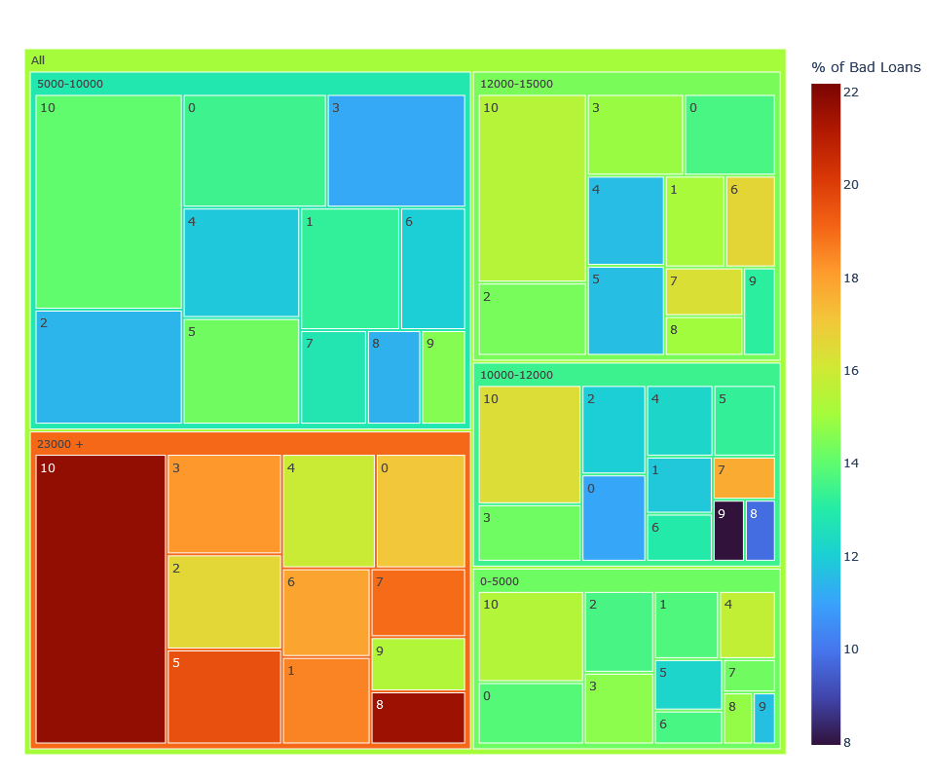
Loan Amount by Employment Length
The highest number of loan defaults are for employees with 10 or more years of experience this could be a reason as people are mostly retired and have no source of income
Size is based on Invested Amount and color and % of default loan (Red is worst
Zoom to see

Slide 34
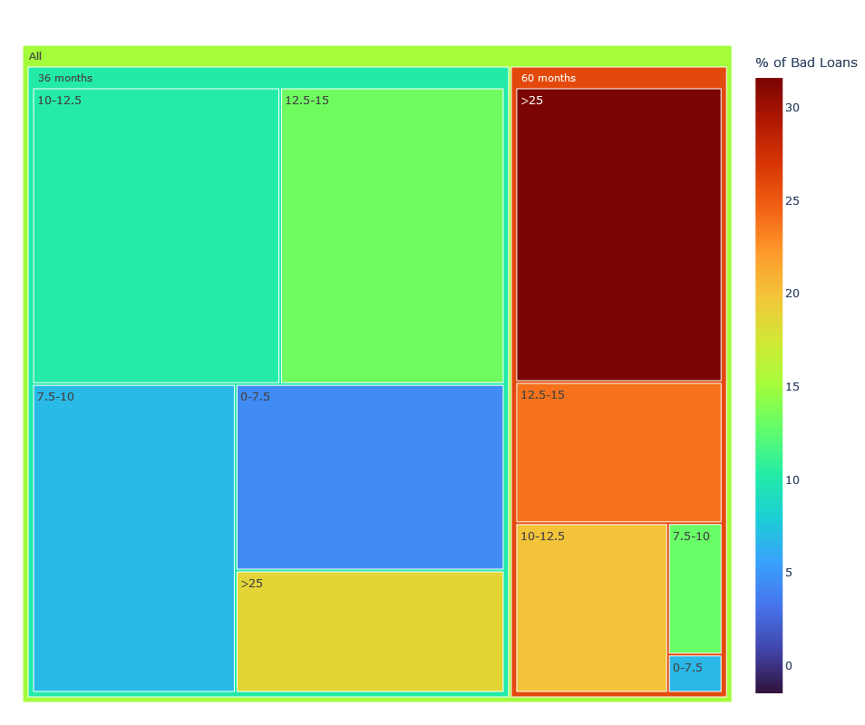
Term By Interest Rate Analysis
All loans issued with 25% or higher interest with respect to all the different terms length (36 or 60 months) lead to a high percentage of loan default.
To reduce future loss do not issue any long-term loans (60 months) in any amount unless you make take all necessary precautions.

Slide 35
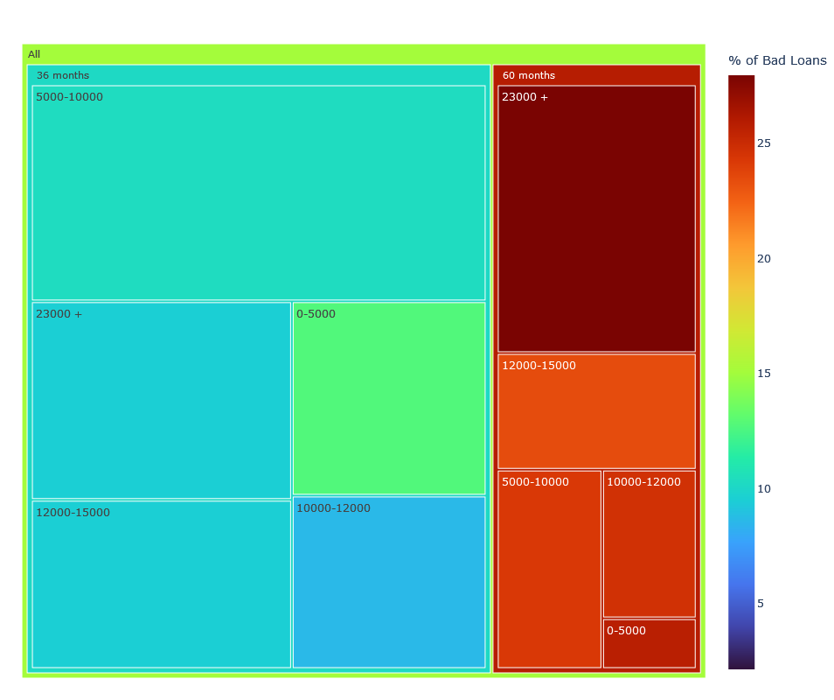
Term by Annual Income Analysis
To conclude and reduce future loss do not issue long term (60 Months) and high amount (23K+) loans.
This is a strong deriving variable to loan default.

Slide 36
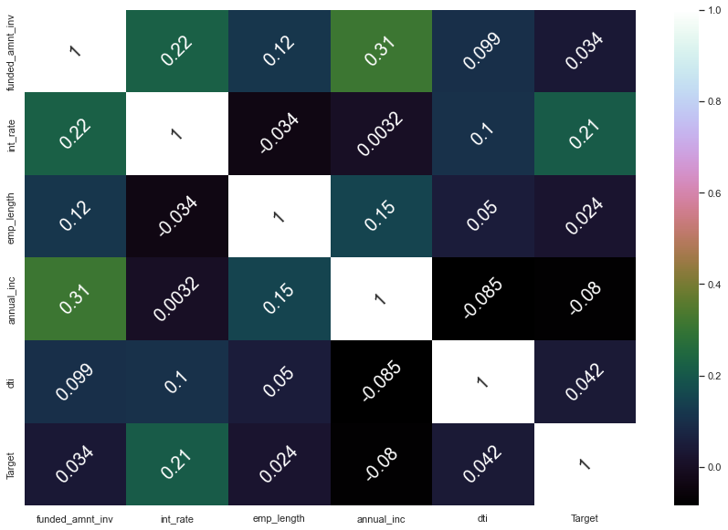
Multivariate analysis of numerical features
There is a positive correlation between the amount funded by investor the client annual income and the interest rate.
To conclude that as the annual income of a borrower increase the investor is more willingly to fund more money.

Slide 37
Deriving Variables to Loan Default.
Interest Rate
Funded Investor amount
Annual Income
Term
Grade
Purpose
DTI

Slide 38
Conclusion

Slide 39
Findings
14% of the data is defaulted loans
Loans issued with greater than 25% interest rate shows high risk on business and has high percentage of loan default. (Interest Rate)
Most of the loans issued are 36-month period, long term loans (6o months) has higher % of loan defaults.
Loan grades A to C are the most common loans issued and can be considered safe to invest. Loan grades D to G is more likelihood to default. (Grade)
Issuing loans for the purpose of small business and Debit consolidation has higher chances of default. ( Purpose)
Issuing loans to people with annual income less than 50 K has a higher risk on business, the higher the annual income of a client the lower the chance of a loan to default. (Annual Income)

Slide 40
Findings Continued…
High value loans issued for clients with annual income less than 100K leads to an increased risk of default.
To reduce business loss do not issue long term loans if the loan interest rate is 10% or higher.
Small business shows the highest % of a loan default, the company must selectively pick applicants in this category. (Purpose)
Funded amounts greater than 23K has the highest % of loan defaults as the funded amount increase the chance of a loan to default increases (Funded Amount)
To conclude and reduce future loss do not issue loans for the purpose of debt consolidation if the loan grade is between (C to F) (Purpose-Grade)

Slide 41
Recommendations
Do not invest in
Do not invest in loans with interest rate 25% and more it has high default ratio unless the annual income if client is above 100K.
Do not invest in
Do not invest in short term loans (36 months) if the client annual income is less than 25K.
Try
Try to avoid investing in loans issued to employees with 10 or more years as they represent a risk of ending as a default and it's recommended to approve only small amounts.

Slide 42
Recommendations cont.
Do not invest loans with interest rate of 12.5% or higher to clients with annual income less than 50k.
Loan Grades A and B are the safest to invest.
Do not issue loans to people with high DTI ratio above 15-25
Do not invest in loans of purpose of small business as it a high risk unless selective screening is made.
Do not approve loans with amounts above 23K unless considerate verification is made on client and the annual income is not less than 100K.

Slide 43
Recommendations cont.
Avoid issuing loans to people who have more than 10 years of employment unless verifying an income source as the highest % and count of defaults is in this criteria.
Higher annual income clients should be given an advantage in approving loans , as they tend to repay their loans when compared with lower income clients.
Do not issue long term loans to individuals with low annual income as long terms means higher interest thus higher monthly payments leading to a business loss.

